Slide 1
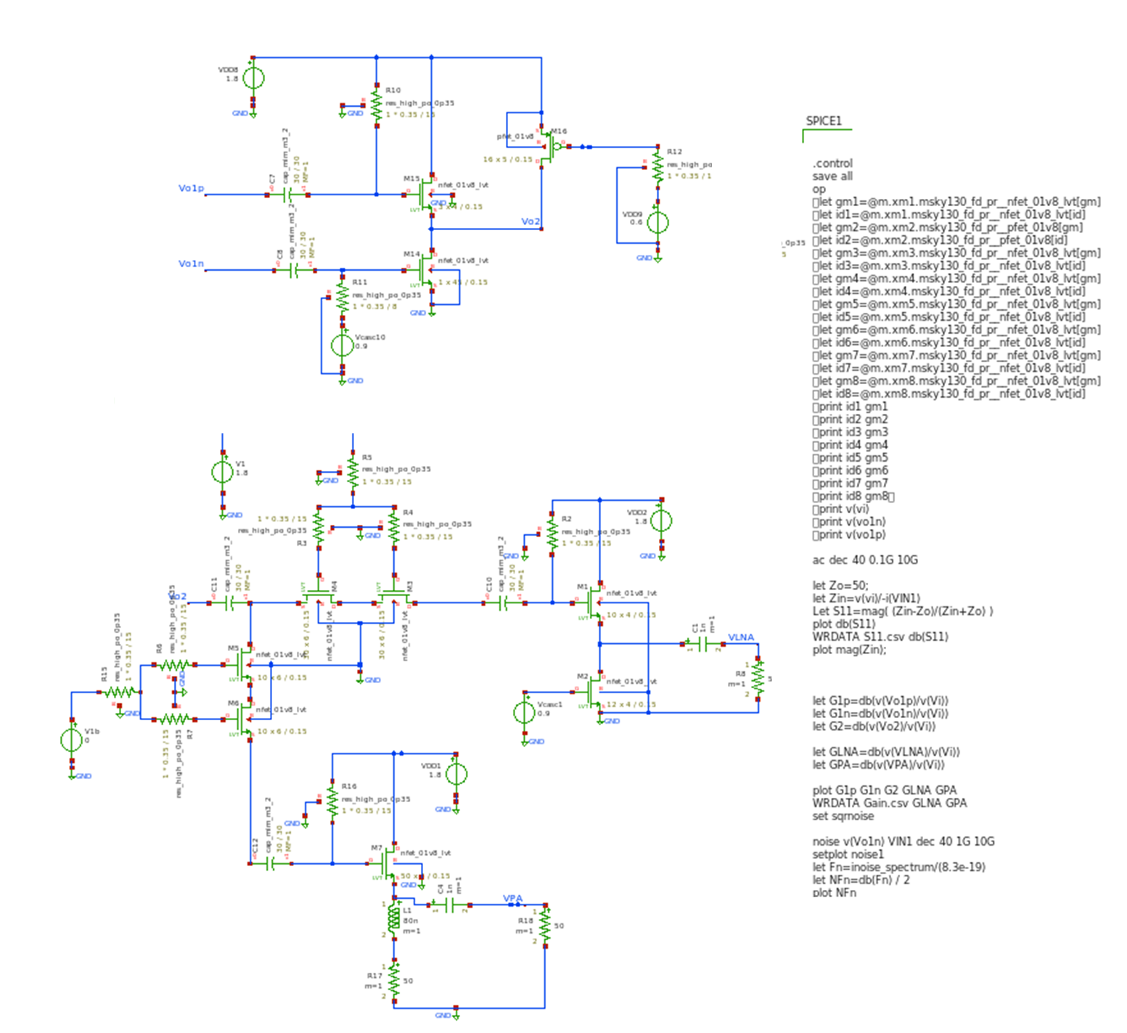
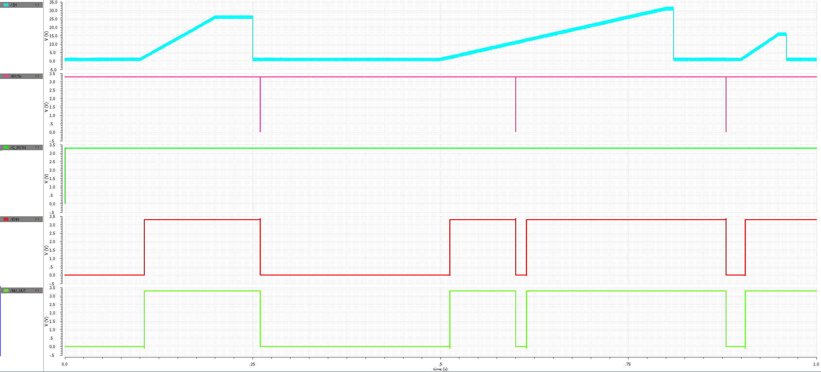
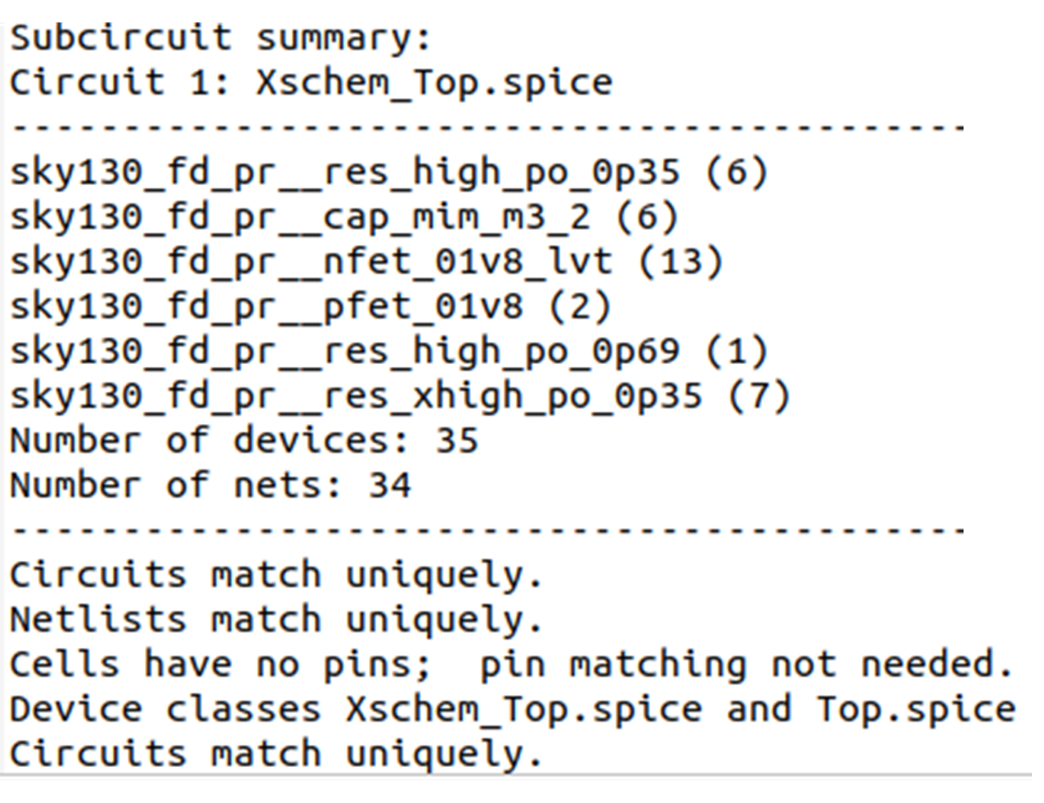
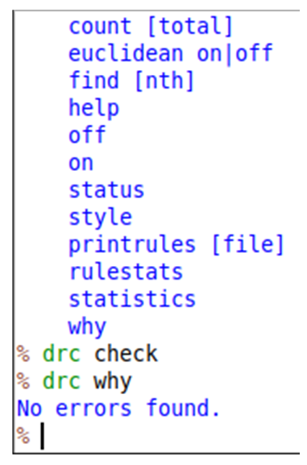
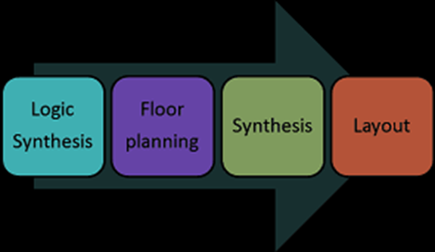
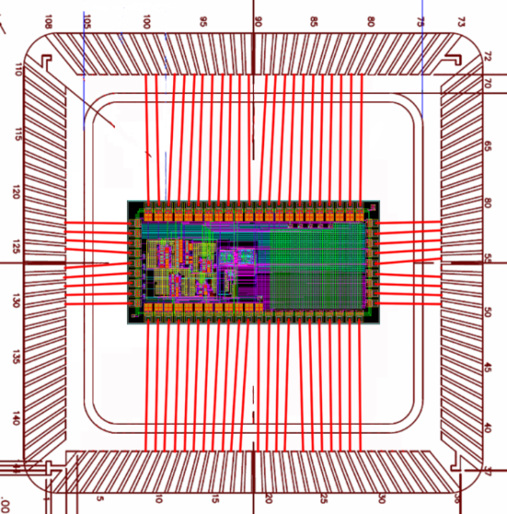
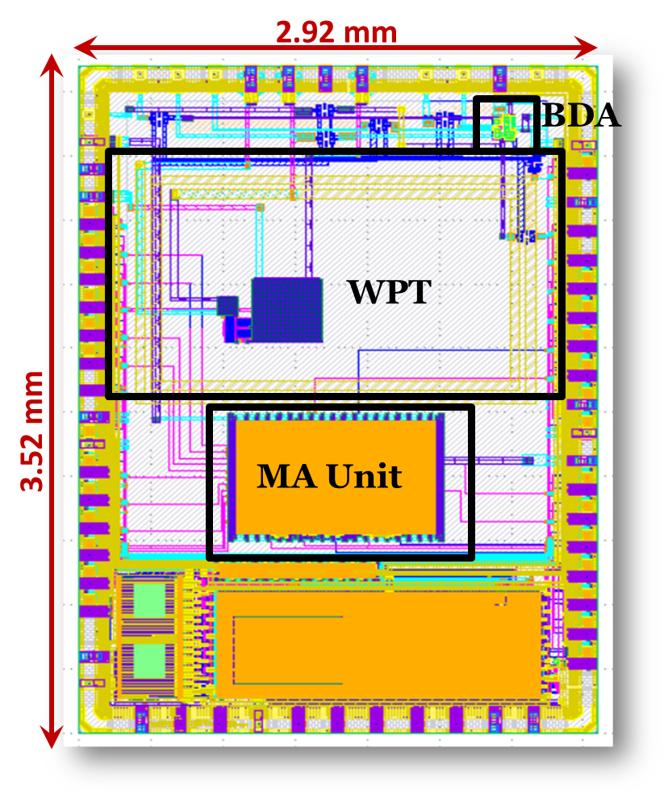
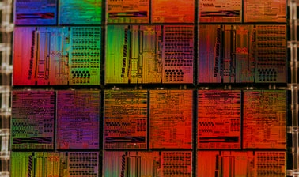

Open Source IC Design Tools Workshop
International Workshop on Analog and Digital IC design flow using Open Source Tools
WORKSHOP OBJECTIVES
SCHEDULE
Introduction to CMOS integrated circuits basics and Open Source tools design flow.
Detailed illustration and hands on experience of complete Open Source integrated circuit system design tools from Schematic to GDS and MPW Prechecks.
Tapeout submission using Open Source Skywater 130nm pdk on eFabless Platform targeting Google sponsored MPW runs.
Day 1
Day 2
Introduction
Guest Note
CMOS Fabrication Process
Open Source Tools
E-fabless Platform
Introduction: Analog and Digital flow
Tools Setup
Analog Design Flow
Schematic Entry
Using Xschem
NGSpice Simulations
Layout Design using
Magic
DRC Verification
LVS Verification
Antenna Rule Checks
Day 3
Day 4
Digital Design Flow
OpenLane Overview
Synthesis
Automatic Placing
and Routing
Clock Tree Synthesis
Post Synthesis
Layout Simulation
Signing OFF
Top Level Integration
Submission for MPW
E-Fabless Final and
Prechecks
E-Fabless Tapeout
Jobs
Q&A Session
Schematic / RTL Design
Simulation and Analysis
Teaching and Technical Staff
Prof. Dr. Rashad Ramzan
Professor & Director RFCS² Lab
FAST, NUCES, ISB.
Engr.Hamza Atiq
MS EE (IC Design ) FAST, NUCES, ISB.
Engr.M Usman
Design Engineer
Fellow MS IC Design
Layout vs Schematic check
Design Rule Check
Custom Layout Design
Output tapped from each SC stage
Output tapped from each SC stage
Dr. Hassan Saif
Asst. Professor at FAST, NUCES, ISB.
Engr.Shahid Jamil Design Engineer
Fellow MS IC Design
Engr.Jafar
Design Engineer
Fellow MS IC Design
Output tapped from each SC stage
Verilog Design Synthesis
Top Level IC Compilation
Pre-checks and Signoff
For more information about our research group please visit our research group website http://isb.nu.edu.pk/rfcs2/
Our Team’s Credibility
Targeted Audience
Pioneer of Graduate IC design program in Pakistan with 44 full-time registered graduate students.
Three designs accepted in SSCS PICO (now Chipathon) Open Source Tapeout Contest and submitted for fabrication in Nov 2021.
Two tapeouts completed in September 2021 using TSMC 65nm node.
Analog, Digital and Mix signal design expertise on Open/Commercial tools Source tools.
Output tapped from each SC stage
BS students with basic electronics knowledge
Final Year EE Students interested in IC Design
MS IC Design Enrolled Students
Faculty Members
Industrial Professionals looking for IC Design skills
Recent Commercial and Open Source Tapeout Projects
Output tapped from each SC stage
Output tapped from each SC stage
Project-1: Backscattering Integration for WPT Receivers
Project-2: Bi-Directional Amplifier Architecture for Sub-6 GHz 5G
Project-3: 64-bit Fused Multiplier Adder Unit with Variable Precision
KAMAL-1
Project-1: Fault-Tolerant CLB
Project-2: Approximate ALU
Project-3: Hardware TRNG
Project-4: mm-Wave LNA
KAMAL-2
Project-1: TENG Harvester
Project-2: AC Logic Family
Project-3: ΣΔ ADC
Project-4: mm-Wave Phase Shifter
Recent Chip Ignite Open Source Projects
School of Electrical Engineering (Islamabad Campus)

